Slide 1
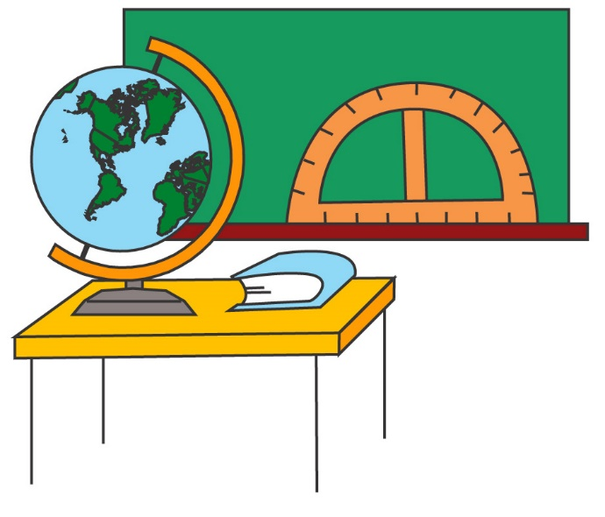
PowerPoint Series on Geography of China (1) – The territory & provincial level administrative units of our country
Personal, Social and Humanities Education Section
Curriculum Development Institute, Education Bureau
Student Self-study Version

Slide 2
The Geographic Location of China
Our country is located within East Asia and is at the west of the Pacific Ocean. Most of our country lies in middle latitudes.
The northernmost tip is at 53°31’ north near the town of Mohe in Heilongjiang province.
The southernmost area is Zengmu Ansha of the Nansha Islands at 4° north.
The westernmost is at the Pamir Plateau of Xinjiang, at 73°40’ east.

Slide 3
The easternmost place is at the confluence of Heilongjiang River and Wusuli River in the east of Fuyuan County, Heilongjiang province, at 135°05’ east.

Slide 4
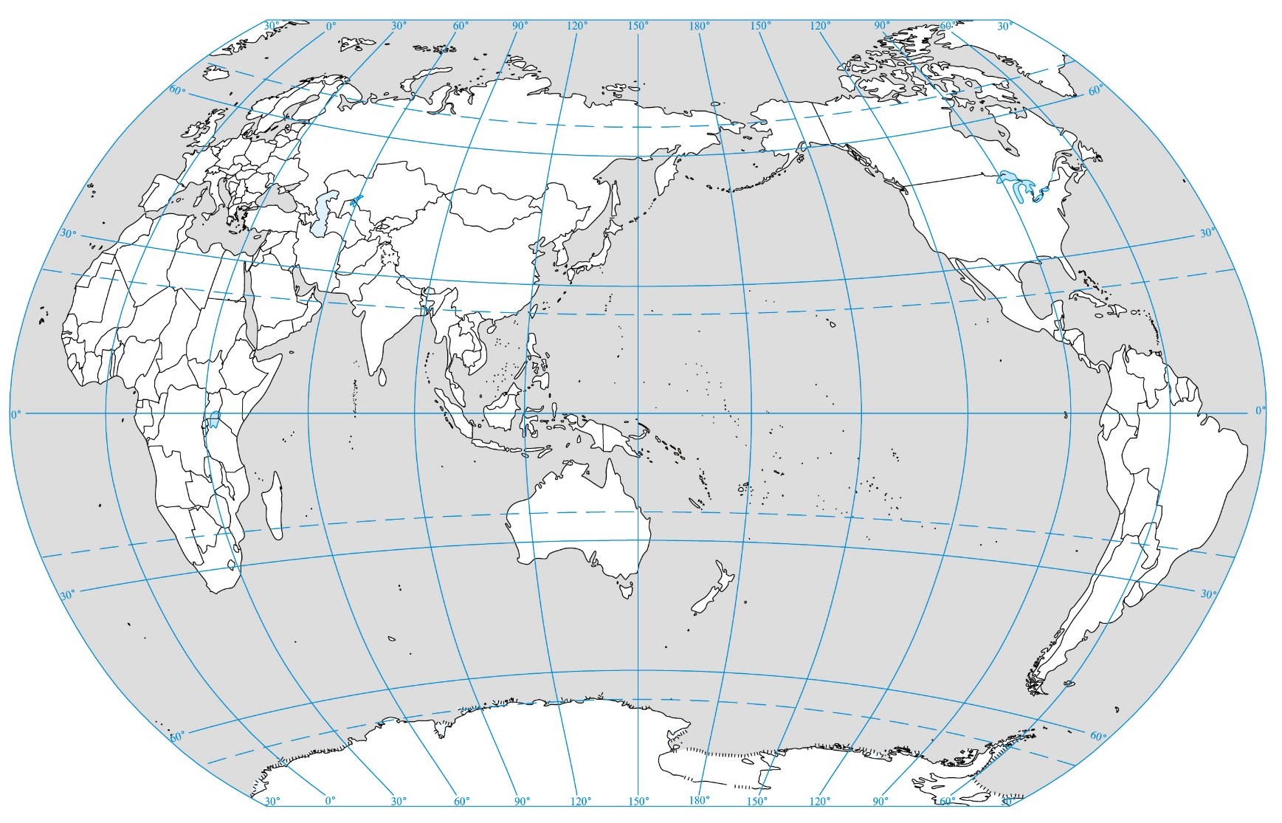
Arctic Circle
66.5ºN
Tropic of Cancer
China
23.5ºN
Equator
Pacific Ocean
0º
Tropic of Capricorn
23.5ºS
Antarctic Circle
66.5ºS
Figure 1 The location map of our country

Slide 5
The Territory & National Borders
Our country has a vast land mass. Its total land area is 9.6 million km², equivalent to a quarter of Asia’s land area or almost equal to the entire land area of Europe.
The coastline of the eastern and southern regions extends over 18,000 km. The total sea area is over 4.7 million km².
There are 7,600 islands of different sizes.

Slide 6
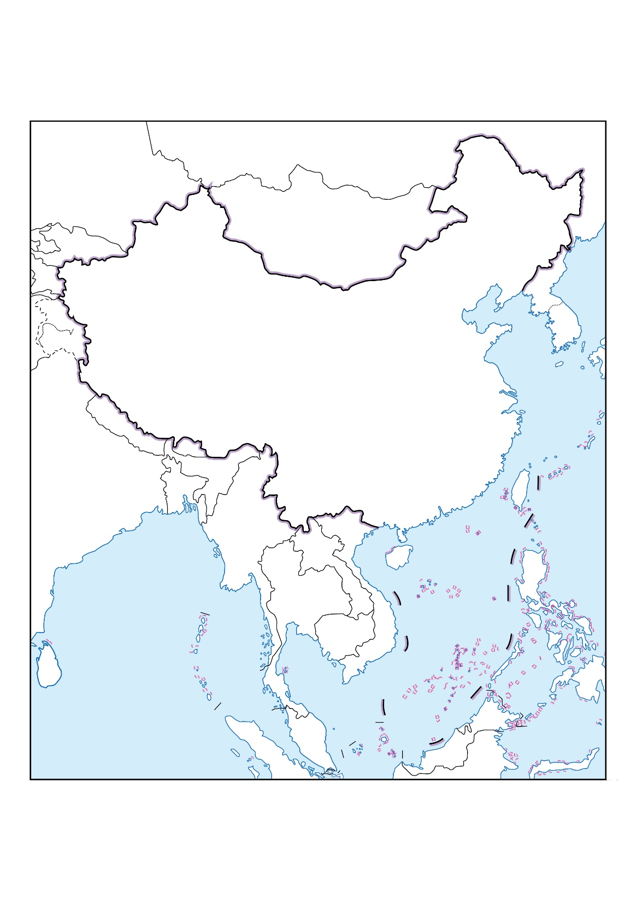
Figure 2 The territory of our country
China

Slide 7
The Seas & Islands
Our country’s territorial waters is composed of 1) the Bohai Sea and the Yellow Sea, 2) the East China Sea, and 3) the South China Sea (Figure 3)
Bohai Sea is shallow and surrounded by land on three sides, covering a total area of about 77,000km². Its water depth averages 18m, with a maximum depth of 70m. It is connected to the Yellow Sea.
The Yellow Sea has an area of 380,000km². Its water depth averages 44m, with a maximum depth of 140m. The Yellow Sea is also shallow.

Slide 8
Figure 3 The territorial seas and major islands
Bohai
Sea
China
Yellow Sea
East China Sea
South China Sea
Taiwan
Hainan Island

Slide 9
The total area of the East China Sea is 770,000km². Its average depth is 349m. Hangzhou Bay is the largest bay in the East China Sea. Major islands in the East China Sea include Taiwan, Zhoushan Islands, Penghu Islands and Diaoyu Islands.
The South China Sea covers a large area of 3.5 million km². The average depth is 1,212m. The major islands in the South China Sea include Hainan Island, Dongsha Islands, Xisha Islands, Zhongsha Islands, and Nansha Islands.
Zengmu Ansha of the Nansha Islands is the southernmost territory of our country.

Slide 10
Taiwan is the largest island, with an area of 35,798km². Mountains and hills account for 69% of its area.
Hainan Island is the second largest island, with a total area of 33,556km². To its north, Hainan Island is separated from Leizhou Peninsula by the Qiongzhou Strait. The narrowest part of the strait is only 18km wide.
Chongming Island is the third largest island, with an area of 1,083km². It is the largest sand bar at the mouth of Chang Jiang and is also the largest alluvial island in our country. Chongming Island is formed by the deposition of sediments and sand transported by Chang Jiang and coastal flows.

Slide 11
Provincial Level Administrative Units
There are 34 administrative units at provincial level, including 4 municipalities, 23 provinces, 5 autonomous regions and 2 Special Administrative Regions (Figure 4 & Table 1). Each administrative division at the provincial level has an abbreviation or an alternative name.
The location of the people’s government of a provincial level division is called the provincial capital city, whereas the location of the People’s Central Government is called the capital city of the country. Beijing is the capital.

Slide 12
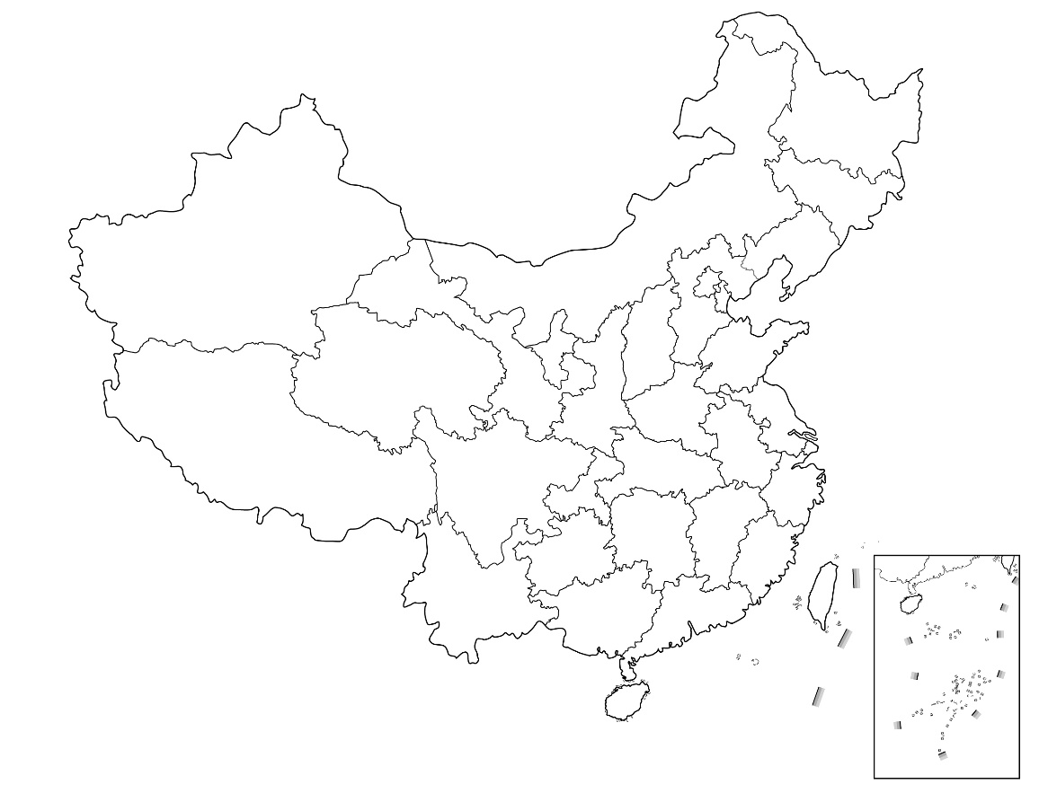
Figure 4 Provincial level administrative units
Beijing
Heilongjiang
Ningxia Huizu Zizhiqu
Jilin
Xinjiang Uygur Zizhiqu
Liaoning
Nei Mongol
Zizhiqu
Gansu
Hebei
Tianjin
Shanxi
Shandong
Qinghai
Shaanxi
Henan
Jiangsu
Xizang Zizhiqu
Shanghai
Hubei
Anhui
Sichuan
Chongqing
Jiangxi
Zhejiang
Hunan
Guizhou
Fujian
Yunnan
Taiwan
Guangdong
Guangxi Zhuangzu Zizhiqu
Hainan
Hong Kong
Macau

Slide 13
Table 1 Provincial level administrative units
Provincial level administrative divisions (Provincial capital) | Abbreviation / (alternative name)
Beijing | Jing
Tianjin | Jin
Hebei (Shijiazhuang) | (Ji)
Shanxi (Tiayuan) | (Jin)
Nei Mongol Zizhiqu / Inner Mongolia Autonomous Region (Hohhot) | Neimenggu
Liaoning (Shenyang) | Liao
Jilin (Changchun) | Ji
Heilongjiang (Harbin) | Hei
Shanghai | (Hu) / (Shen)
Jiangsu (Nanjing) | Su
Zhejiang (Hangzhou) | Zhe
Anhui (Hefei) | (Wan)
Fujian (Fuzhou) | (Min)
Jiangxi (Nanchang) | (Gan)

Slide 14
Provincial level administrative divisions (Provincial capital) | Abbreviation / (alternative name)
Shandong (Jinan) | (Lu)
Henan (Zhengzhou) | (Yu)
Hubei (Wuhan) | (E)
Hunan (Changsha) | (Xiang)
Guangdong (Guangzhou) | (Yue)
Guangxi Zhuangzu Zizhiqu / Guangxi Zhuang Autonomous Region (Nanning) | (Gui)
Hainan (Haikou) | Qiong
Chongqing | (Yu)
Sichuan (Chengdu) | Chuan / (Shu)
Guizhou (Guiyang) | Gui / (Qian)
Yunnan (Kunming) | Yun / (Dian)
Xizang Zizhiqu / Tibet Autonomous Region (Lhasa) | Zang
Shaanxi (Xian) | Shan / (Qin)
Gansu (Lanzhou) | Gan / (Long)

Slide 15
Provincial level administrative divisions (Provincial capital) | Abbreviation / (alternative name)
Qinghai (Xining) | Qing
Ningxia Huizu Zizhiqu / Ningxia Hui Autonomous Region (Yinchuan) | Ning
Xinjiang Uygur Zizhiqu / Xinjiang Uygur Autonomous Region (Urumqi) | Xin
Hong Kong Special Administrative Region | Gang
Macau Special Administrative Region | Ao
Taiwan | Tai

